Slide 1

What makes a Strong GDP?
Created by Rtists

Slide 2
DATA & GOALS
Data
Goals
185 countries
16 variables (3C, 13N)
Collected in 2019
12 countries omitted due to poor data collection policies
Determine the driving factors behind GDP
Build a model that maximally explains variation in GDP
Guide policymakers in breaking down economic barriers

Slide 3
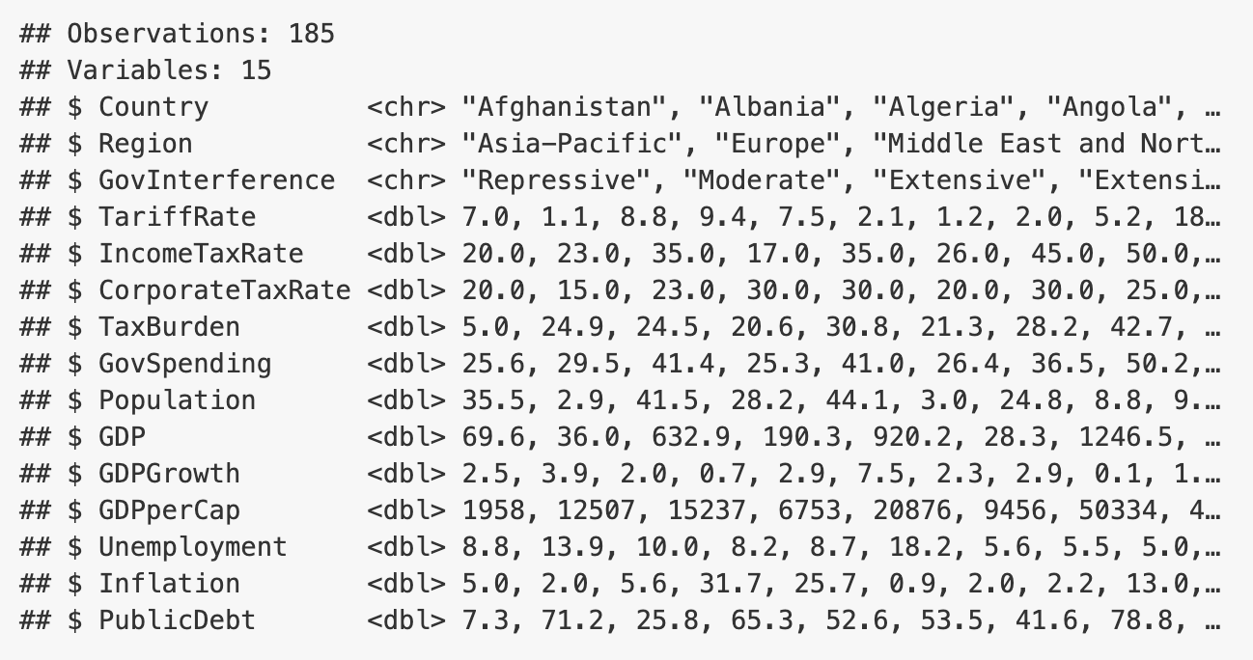

Slide 4

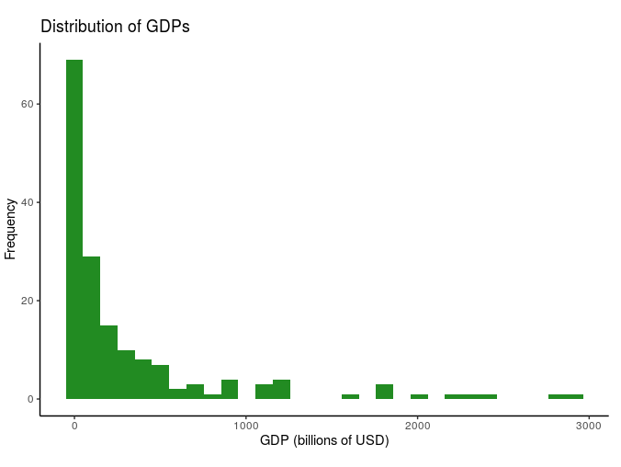
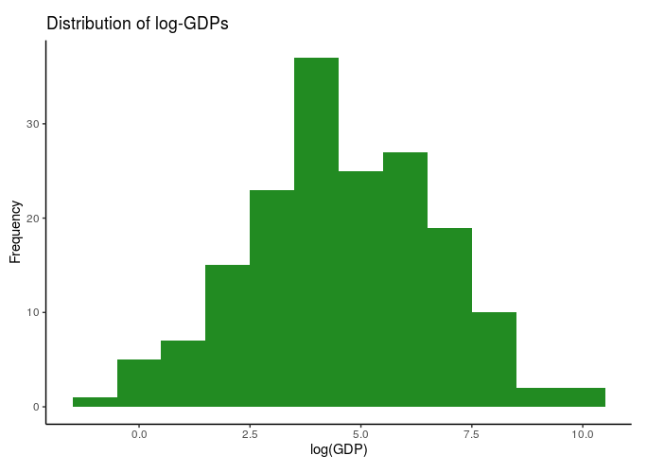
Univariate analysis: GDP

Slide 5
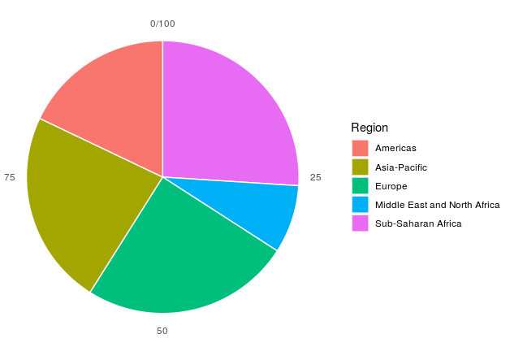
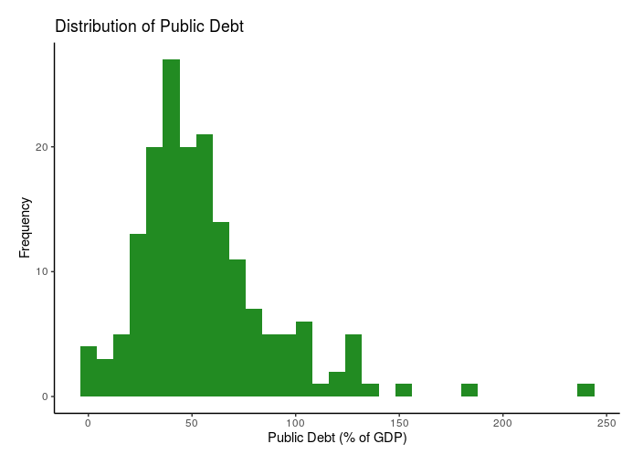
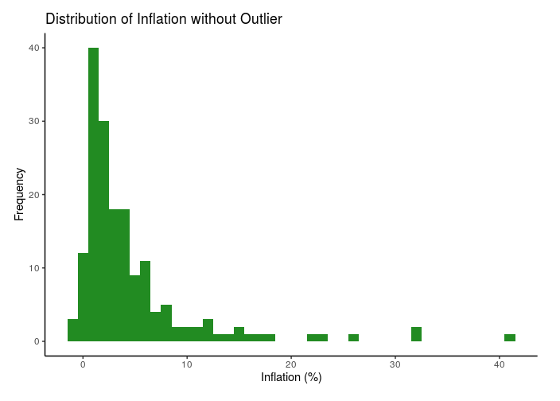
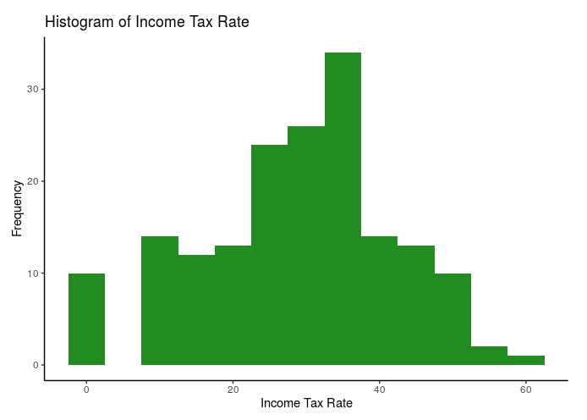
Univariate analysis
Region Public Debt
Inflation Income Tax Rate

Slide 6
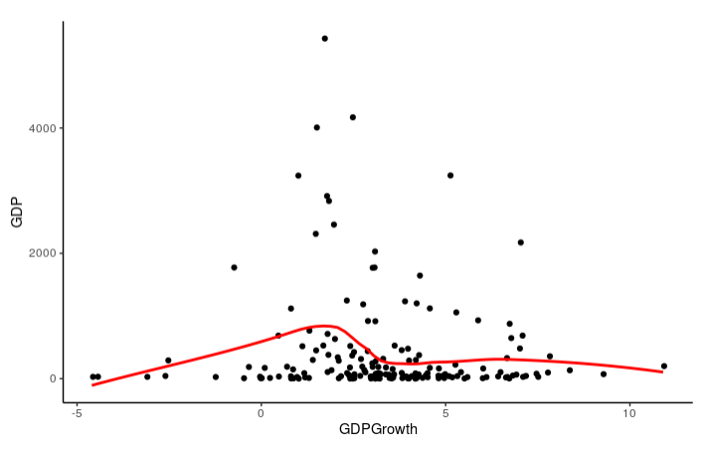
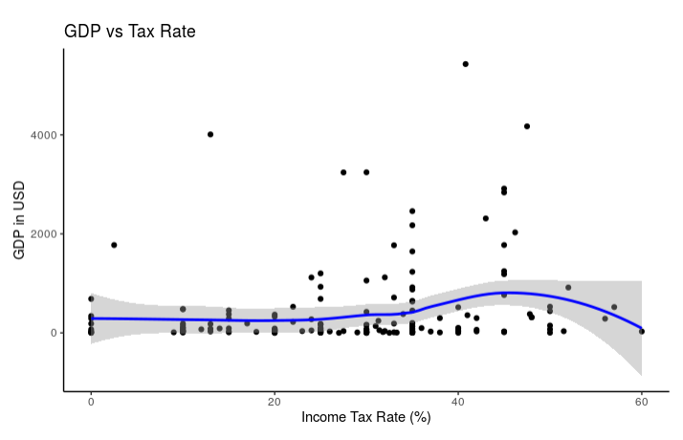
Interesting Relationships
Income Tax & GDP are share an oddly weak relationship
GDP & GDP Growth are inversely related

Slide 7
Model Creation
Selection Order: Forward, Backward
Selection Criteria:
AIC, BIC, adj R2
Same model for each selection Order
All selected: TariffRate + logpop + GDPGrowth + GovInterference
Partially selected predictors variables & Interactions were evaluated with nested-f tests

Slide 8
Possible Variables
Final Model
TariffRate
Logpop
TaxBurden
GDP Growth
Inflation
GovInterference
Region
CorporateTaxRate
IncomeTaxRate
GovSpending
Unemployment
PublicDebt
TariffRate: -.009
Logpop: 1.006
TaxBurden: -.02
GDPGrowth: -.057
Inflation (Categorical)
GovInterference (Categorical)
Region (Categorical)
Intercept: 3.117
Interaction: TariffRate X Region
Interaction: TariffRate X GovInterference
Final R² : 84.2%​
​

Slide 9
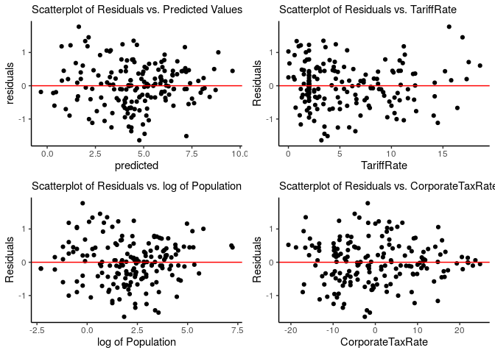
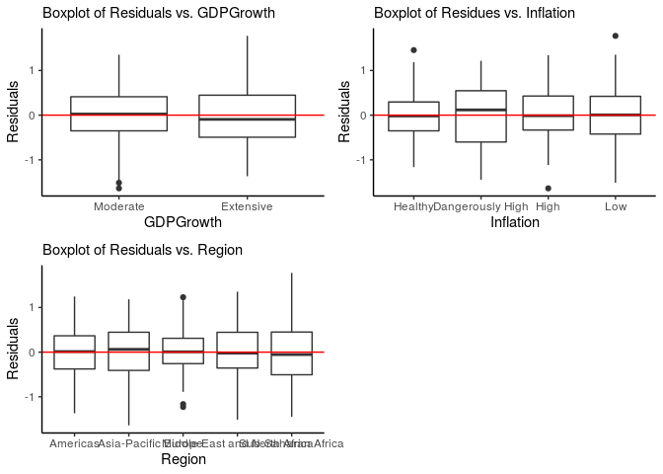
Constant Variance + Linearity
Notes:
After the model is made, we need to check for model diagnostics and assumptions. We chose MLR model because the response variable is continuous and there are multiple predictor variables including both quantitative ones and categorical ones.

Slide 10
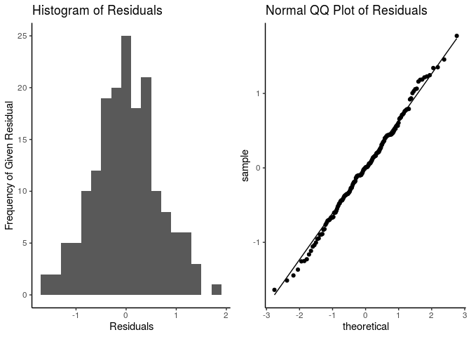
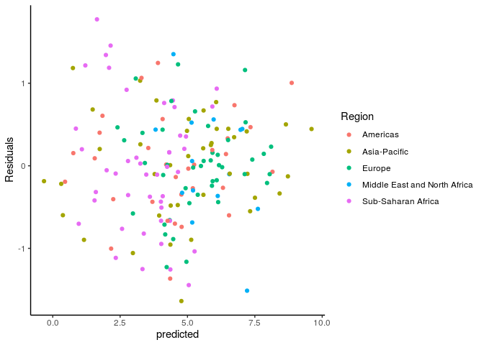
normality
Independence

Slide 11
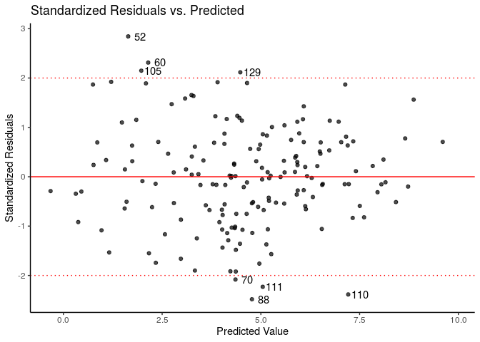
MODEL DIAGNOSTICS

Slide 12
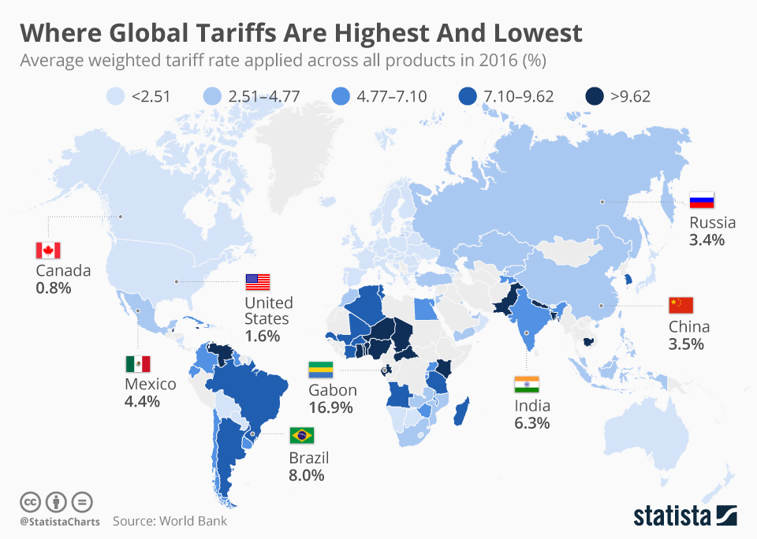
Surprising Findings & Interpretations
TariffRate X Region
Countries in the Americas have the highest estimate in this interaction
Suggests that Americas suffer less repercussions for tariffs
Population
Dominant term for most countries
Suggests that population growth may be efficient way to make further growth
Inflation Interactions
None proved significant
Currency stability?

Slide 13
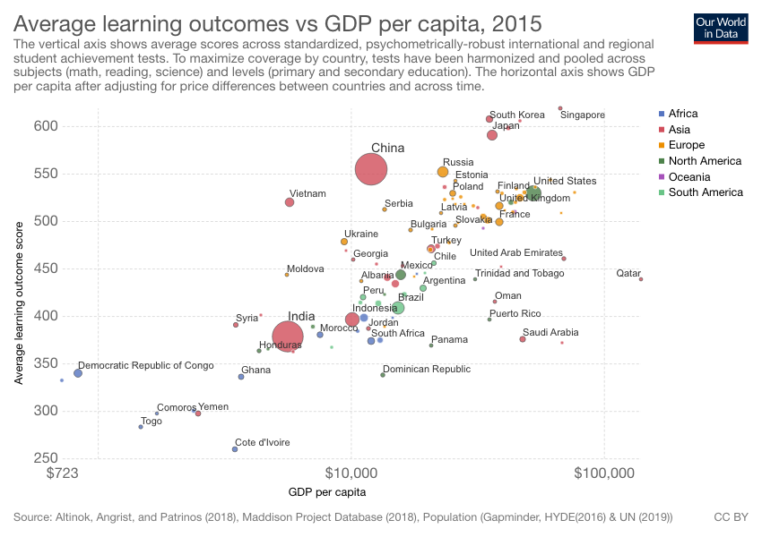
Challenges & Issues
Omitted Countries
12 total
Includes Somalia, Iraq, North Korea, etc
Mostly developing countries
Poor data collection
Independence
Economic stats are very complex
Many indicators are often related to each other, leading to potential multicollinearity
Future Project: Add Non-Economic Indicators!

Slide 14
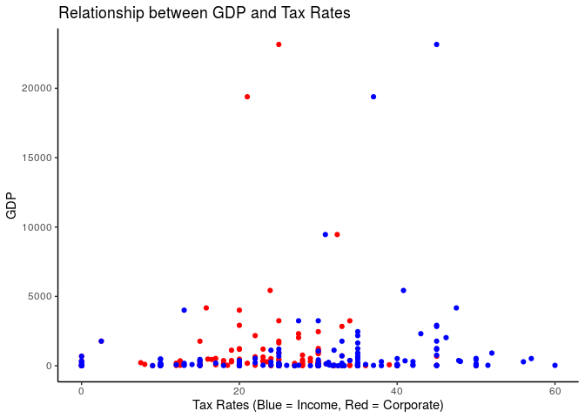
The Big picture
Much of a country's GDP is out of the government's control
Region found to be a significant predictor and interacts with other predictors
Improving GDP is an international effort, not a solo one
Tariff rates were significant and interacted with other variables
Short term solutions trade off with long-term improvements
Tax rates, public debt not found to be significant
Extreme measures usually fail

Slide 15
End

Slide 16
Credits & References
Constantin ANGHELACHE & Vergil VOINEAGU & Diana Valentina SOARE & Daniel DUMITRESCU, 2013. "The Economy of Romania during the Period 2000-2012," Romanian Statistical Review Supplement, Romanian Statistical Review, vol. 61(1), pages 96-104, March.
“Country Rankings.” Country Rankings: World & Global Economy Rankings on Economic Freedom, Heritage Foundation, 2019, https://www.heritage.org/index/ranking.
J D Urrutia et al. 2017. J. Phys.: Conf. Ser. 820 012008

